Slide 1
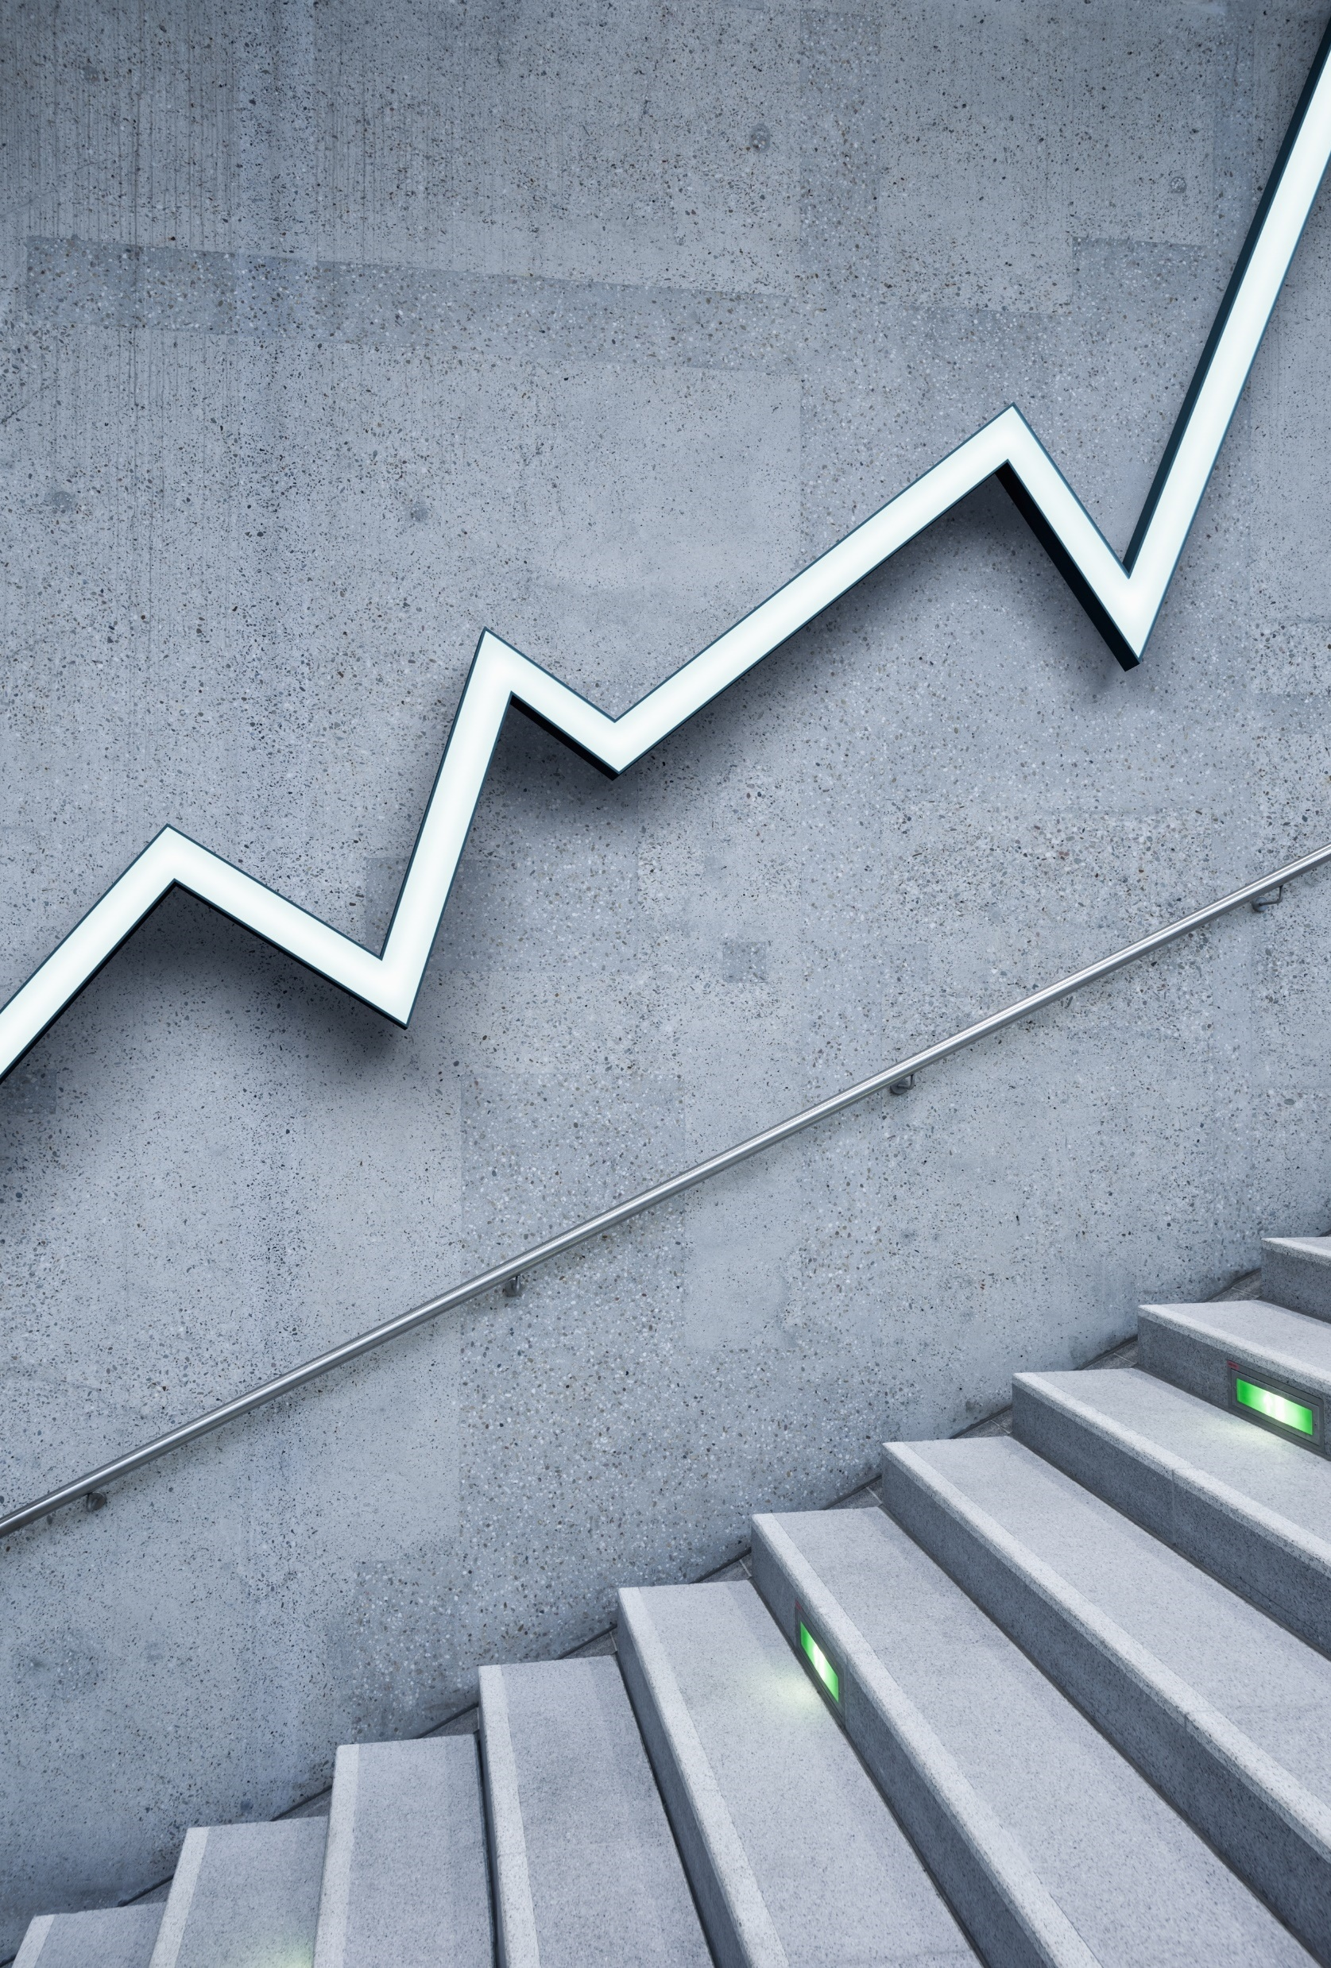
Machine learning

Slide 2
Slide 1: Title Slide
Title: Understanding Supervised and Unsupervised Learning Subtitle: A Simplified Overview for Senior Policy Makers Presented by: [Your Name] Date: [Insert Date] Wadhwani Foundation / WGDT

Slide 3
Slide 2: Introduction to Machine Learning
Title: What is Machine Learning?
Machine Learning (ML) is a type of Artificial Intelligence (AI) that allows computers to learn from data without explicit programming.
ML helps make predictions, detect patterns, and automate tasks based on data.
Key Takeaways:
ML is like teaching computers to make decisions based on data.
Helps improve systems over time with more data

Slide 4
Slide 3: Types of Machine Learning
Title: Supervised vs. Unsupervised Learning
Supervised Learning: Training a model on labeled data (known input-output pairs) to make predictions.
Unsupervised Learning: Finding patterns or groupings in data without labeled outcomes.
Visual: A simple diagram contrasting Supervised and Unsupervised learning.

Slide 5
Slide 4: What is Supervised Learning?
Title: Supervised Learning: Overview
Definition: In supervised learning, we teach the machine using data that includes both inputs (features) and correct outputs (labels).
The goal is to make predictions for new, unseen data based on the learning.
Example in Agriculture:
Crop Disease Detection: Train the model with images of healthy vs. diseased crops, then predict whether a new crop is diseased or healthy.
Visual: A diagram showing input data (images of crops) and output (disease/no disease labels).

Slide 6
Slide 5: Supervised Learning Example
Title: Example – Predicting Crop Yield
Scenario: You have data from past years: weather, soil quality, water availability, etc.
The system learns from this data (input-output relationships) to predict how much yield a crop will produce in future seasons.
Key Outcome: Predict crop yield based on historical data.
Visual: Show a graph with weather and soil data vs. crop yield.

Slide 7
Slide 6: What is Unsupervised Learning?
Title: Unsupervised Learning: Overview
Definition: Unsupervised learning looks for patterns in data without labels or outcomes.
It identifies structures like groups, trends, or relationships hidden within the data.
Example in Agriculture:
Market Segmentation: Identify groups of farmers with similar buying behaviors for targeted policy interventions.
Visual: Diagram showing data being grouped into clusters.

Slide 8
Slide 7: Unsupervised Learning Example
Title: Example – Grouping Farmers by Needs
Scenario: Analyzing purchasing behavior of farmers in different regions (data like types of seeds, tools, and fertilizers bought).
The machine groups similar farmers together, helping create region-specific policies.
Key Outcome: Create more targeted policies for different farmer segments.
Visual: A cluster diagram showing different farmer groups.

Slide 9
Slide 8: Key Differences Between Supervised and Unsupervised Learning
Title: Key Differences
Supervised Learning | Unsupervised Learning
Requires labeled data (input-output pairs) | Uses only input data (no labeled outcomes)
Makes predictions based on past data | Finds patterns or groups in the data
Example: Crop Disease Detection | Example: Grouping Farmers for Policy Targeting

Slide 10
Slide 9: Applications in Agriculture
Title: How These Learning Techniques Can Help Agriculture
Supervised Learning: Predicting crop disease, yield forecasting, soil quality assessment.
Unsupervised Learning: Market segmentation, detecting outliers in farming data, grouping farmers by needs.
Visual: Show both types of learning with agriculture-related icons.

Slide 11
Slide 10: Demo Overview
Title: Demonstration: Supervised vs. Unsupervised Learning in Action
Supervised Learning Demo: Show a model predicting the health of crops from an image dataset.
Unsupervised Learning Demo: Show clustering of farmers based on purchase behavior.
Visual: Screenshots of simple data visualizations or a flowchart of the process.

Slide 12
Slide 11: Benefits of Machine Learning for Agriculture
Title: Benefits to the Agriculture Sector
Better Predictions: Forecast crop yields, disease outbreaks, and market demand.
Personalized Solutions: Tailored interventions based on farmer behavior and needs.
Efficiency & Automation: Streamline processes, saving time and resources.
Visual: Infographic showing these key benefits.

Slide 13
Slide 12: Q&A
Title: Questions & Discussion
Open the floor for questions.
Encourage feedback and discussions on how these concepts can be implemented in policy-making.

Slide 14
Slide 13: Conclusion
Title: Conclusion & Next Steps
ML can help transform agriculture by providing data-driven insights for better decision-making.
Collaboration between government and technology experts can unlock new possibilities for farmers’ welfare.
Closing Statement: Thank you for your time and attention. Let's work together to leverage technology for agricultural advancement.

Slide 15
Your best quote that reflects your approach… “It’s one small step for man, one giant leap for mankind.”
- Neil Armstrong

